Slide 1
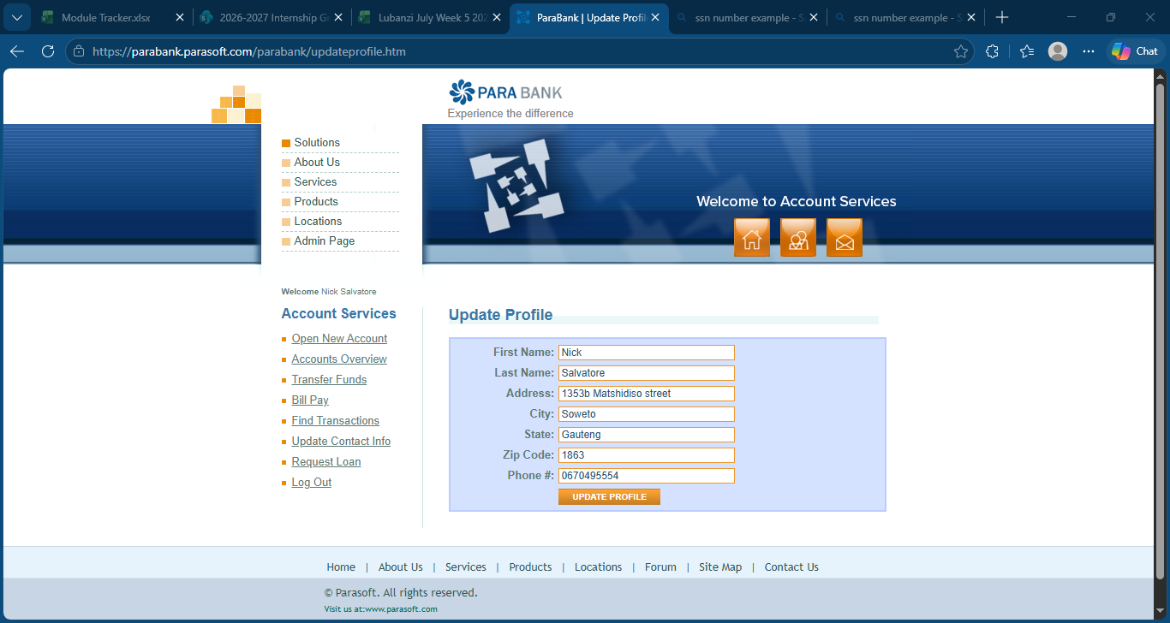
Registration Screenshot

Slide 2
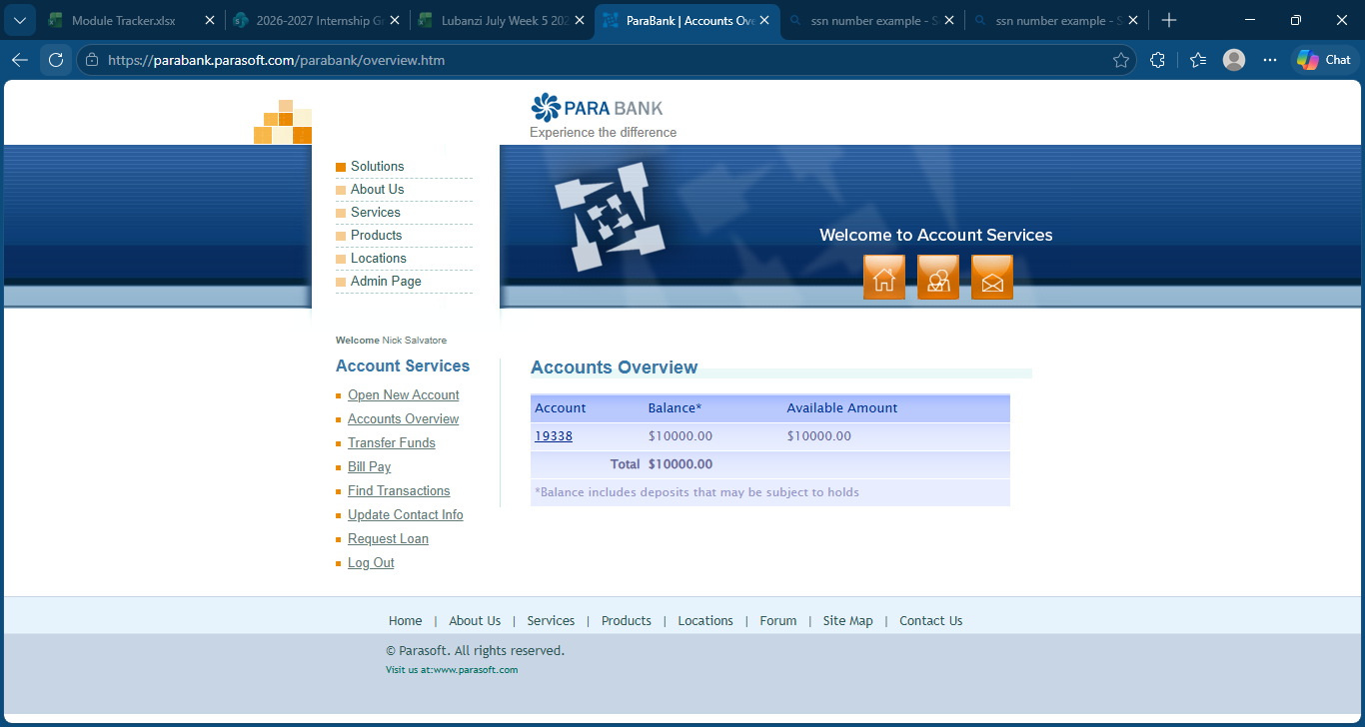
Login and AccountOverview

Slide 3
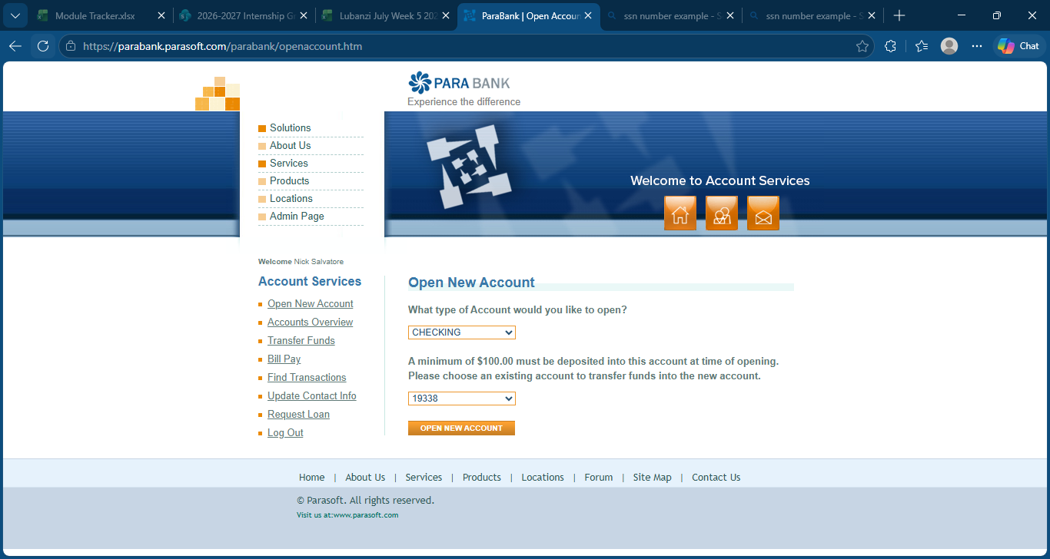
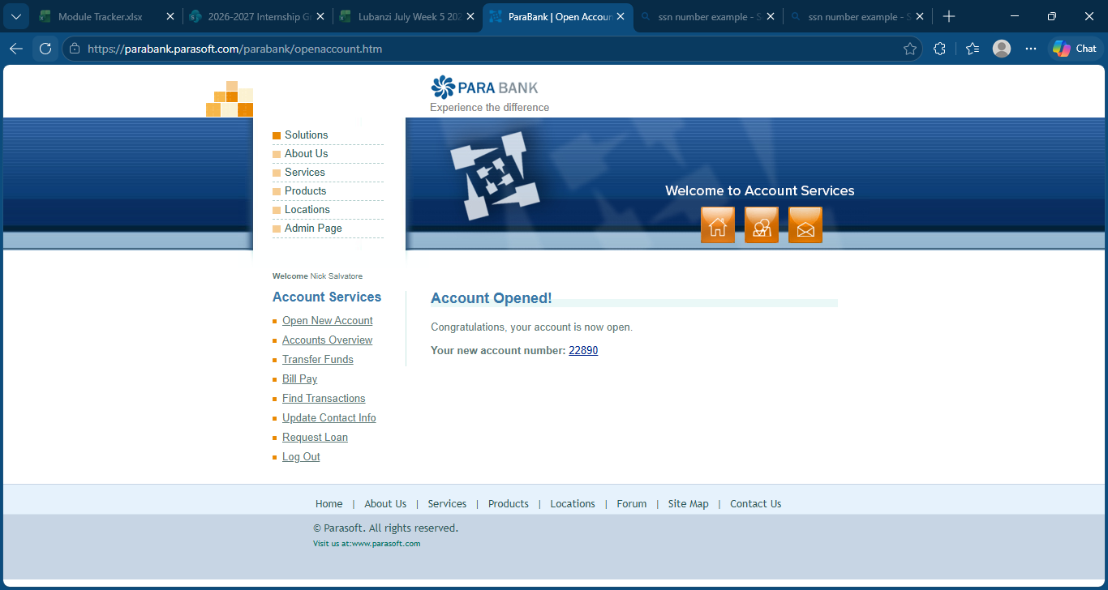
Opened new savings Account

Slide 4

Transfer funds to Savings Account

Slide 5
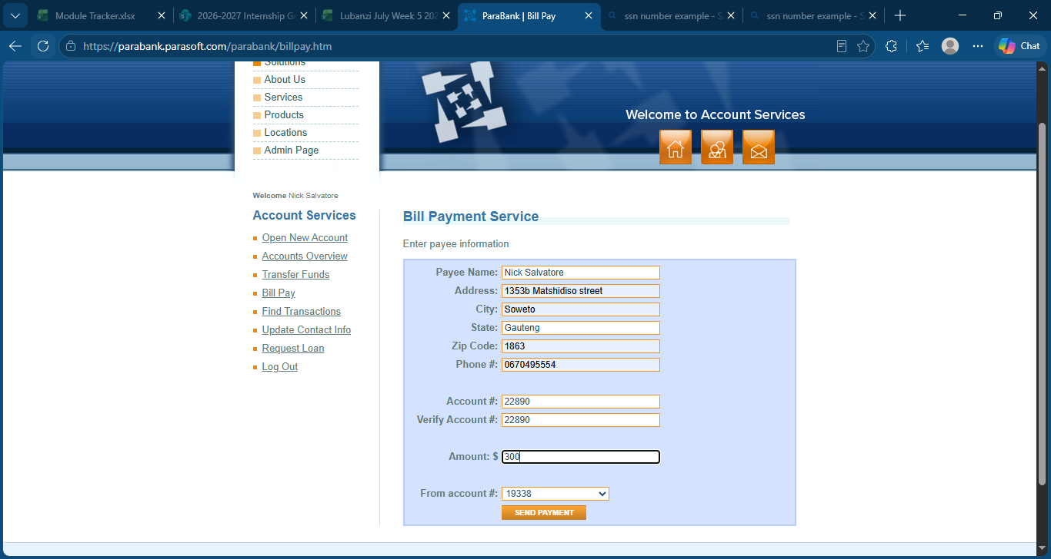

Bill Payment Workflow

Slide 9
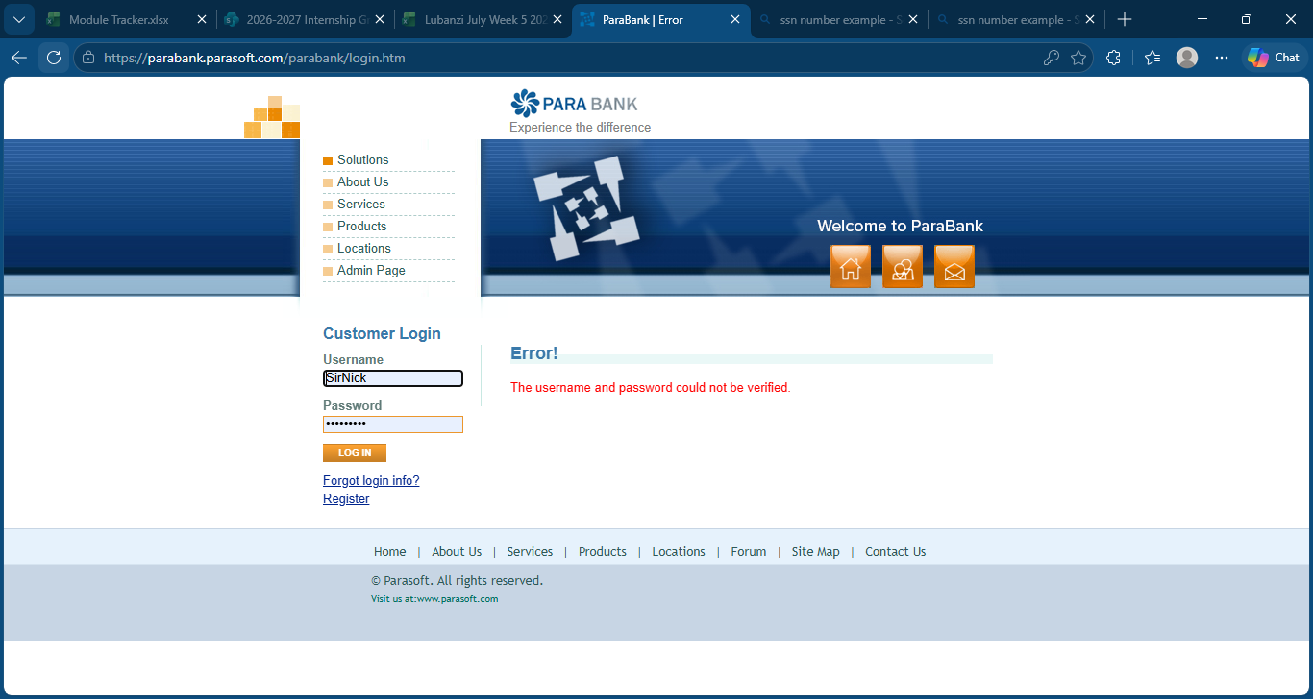
Defacts found
The website logged me out after 30+ minutes of being idle, not only that but my profile has been deleted along with its contents.

